Slide 1
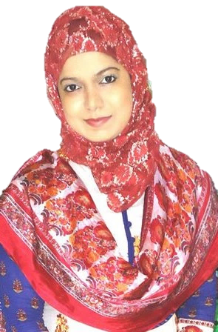


Introduction to Business (BUS 101). Lecture Delivered by: Nusrat Hafiz (NHF)

Slide 2
Discussion Agenda
Introduction to Business (BUS 101). Course Instructor: Nusrat Hafiz (NHF)
Business Environment
(II) Technological Environment
(III) Competitive Environment

Slide 3
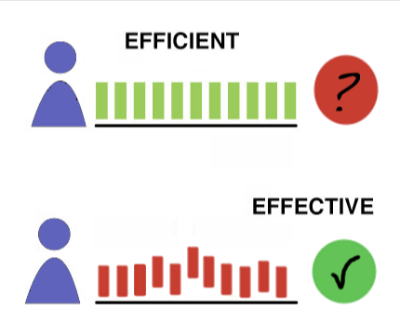
2. TECHNOLOGICAL ENVIRONMENT
Introduction to Business (BUS 101). Course Instructor: Nusrat Hafiz (NHF)
*
How Technology Benefits Workers and You
Technology -- Everything from phones to copiers and the various
software programs that make businesses more effective, efficient
and productive.
Effectiveness -- Producing the desired result.
(doing the right things)
Efficiency -- Producing goods and services using
the least amount of resources. (doing thing right)
Productivity -- The amount of output you generate given the amount of input (example: hours you work).
*
LG4
1-3

Slide 4

2. TECHNOLOGICAL ENVIRONMENT
Introduction to Business (BUS 101). Course Instructor: Nusrat Hafiz (NHF)
*
Food for thought: Does being busy means being productive?
https://youtu.be/HPLBwuj7sMA
How Technology Benefits Workers and You
*
LG4
1-4

Slide 5
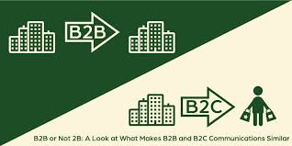
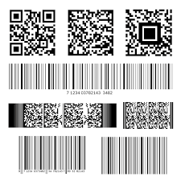

BENEFITS of TECHNOLOGY
Introduction to Business (BUS 101). Course Instructor: Nusrat Hafiz (NHF)
*
How Technology Benefits Workers and You
*
LG4
E-Commerce-- The buying and selling of goods
and services over the internet.(B2B, B2C).
Universal Product Code helps scan what product
was bought, in what size and color and at what price.
A scanner at the checkout counter can read that
information and put it into a Database, which is an
electronic storage file where vast amounts of information
about customers (name, address, telephone numbers) are
stored.
Identity theft is the obtaining of individual personal
information for illegal purpose.
1-5

Slide 6


3. COMPETITIVE ENVIRONMENT
*
Introduction to Business (BUS 101). Course Instructor: Nusrat Hafiz (NHF)
The Competitive Environment
*
LG5
Firms should offer both high quality product and outstanding services at competitive price.
Need to know the competitors
1-6

Slide 7
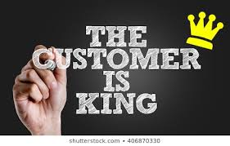

3. COMPETITIVE ENVIRONMENT
*
Introduction to Business (BUS 101). Course Instructor: Nusrat Hafiz (NHF)
The Competitive Environment
*
LG5
Two ways to compete:
by exceeding customer expectations
by restructuring and empowering the employees
1-7

Slide 8
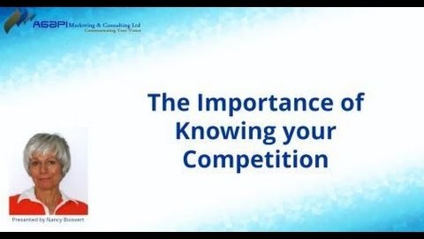
Introduction to Business (BUS 101). Course Instructor: Nusrat Hafiz (NHF)
*
Mini Activity: (2) Based on the video, elaborate why do you need to know your competition? Include a real-life example.
https://youtu.be/5RSd44og8xw
*
LG3
1-8

